Slide 1
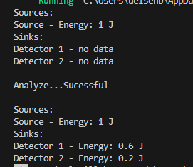
Simple setup (filter system)
Input energy: 1J
60/40 Beam splitter
50% filter

Slide 2
Simulating double-pass systems
Solution: „Reference nodes“
Does not work!
(would form a loop)
linked elements
(inverted)

Slide 3
Example: Michaelson Interferometer

Slide 4
Further Nodes
Group nodes: Nesting optical paths in a node (using sub-graphs)
Non-sequential groups:
free raytracing with defined external input/output ports
e.g. illumination of pump cavities
Non-linear optic nodes (SHG…)
Real lenses
modelled as groups (surface node -> propagation node -> surface node)
Undirected nodes for resonators?

